Slide 1
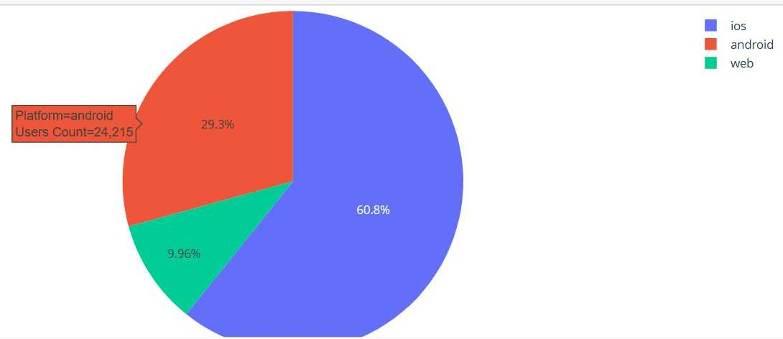


Platform Marketing
Insights
Applying A/B testing and user e perience optimization techniques to improve conversion rates. Leveraging insights to reﬁne marketing strategies and enhance user engagement.

Slide 2
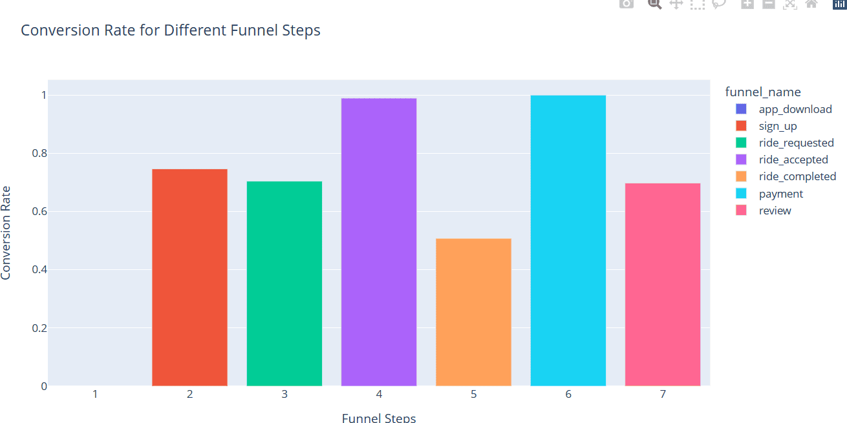

Conversion rate
•Strong Signup Engagement
Active Requesting
•E cient Driver Acceptance
Pickup Stage Challenge
•Smooth Payment Transition
Review Engagement

